Slide 1
Battery Management System Chengdu BMS Project- 18th December 2019 Jing Wang
Realize innovation.
Restricted © Siemens AG 2019
Siemens PLM-Nissan Confidential

Slide 2
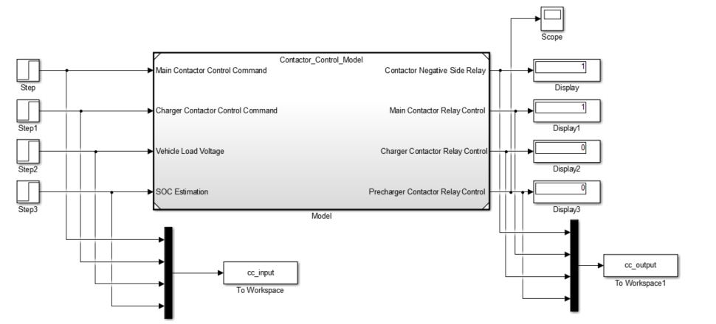
Contactor Control Open Loop Testing Harness
Testing Harness: simulation block that is used to test contactor control logic
Inputs: main contactor control command, charger contactor control command, vehicle load voltage, SOC estimation
Outputs: contactor negative side relay, main contactor relay control, charger contactor relay control and pre-charger contactor relay control

Slide 3
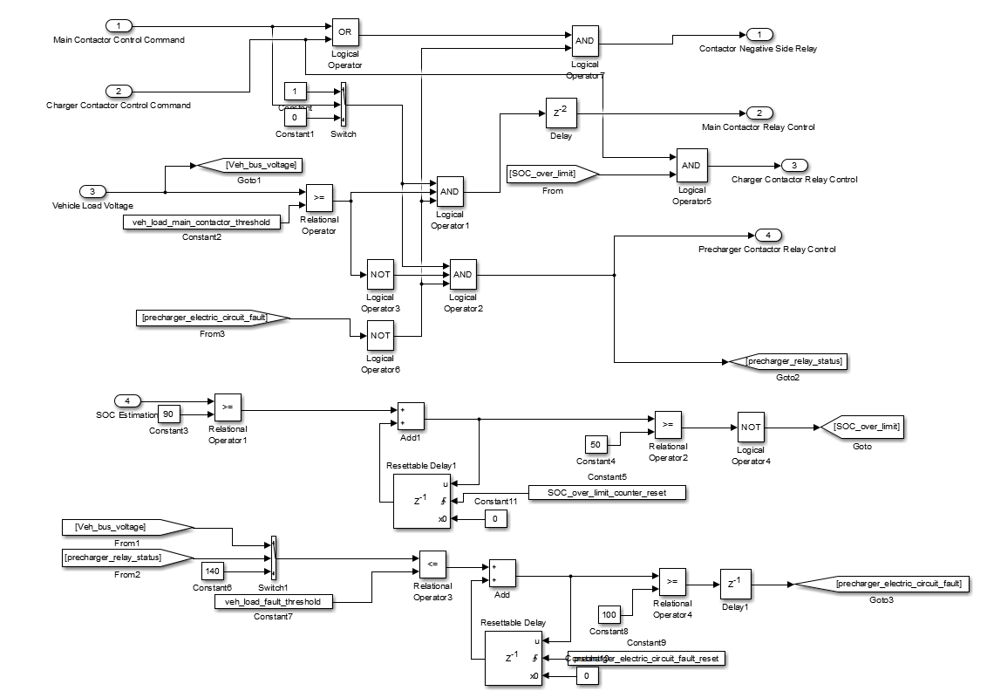
Contactor Control Simulink Model
Internal control logic to determine control contactor negative side relay, positive side relay and pre-charger relay state
Diagnostic signal is also developed to indicate electronic circuit error during start up process

Slide 4
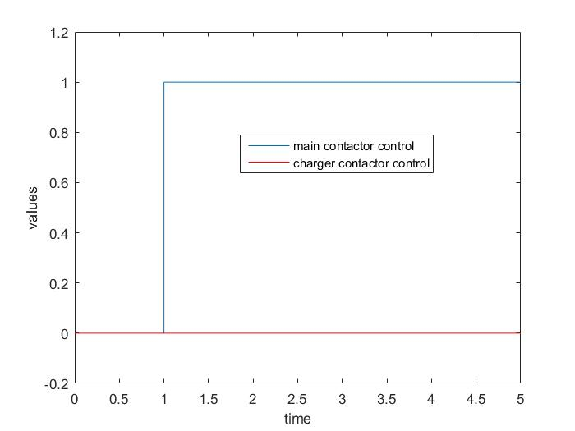
Contactor Control Test Results: Test 1 Inputs
In the first test, we set the main contactor control signal to be 1 after 1 seconds as shown above
The main objective is to check if the pre-charger contactor relay, the main contactor relay and the contactor negative side relay are functional properly

Slide 5
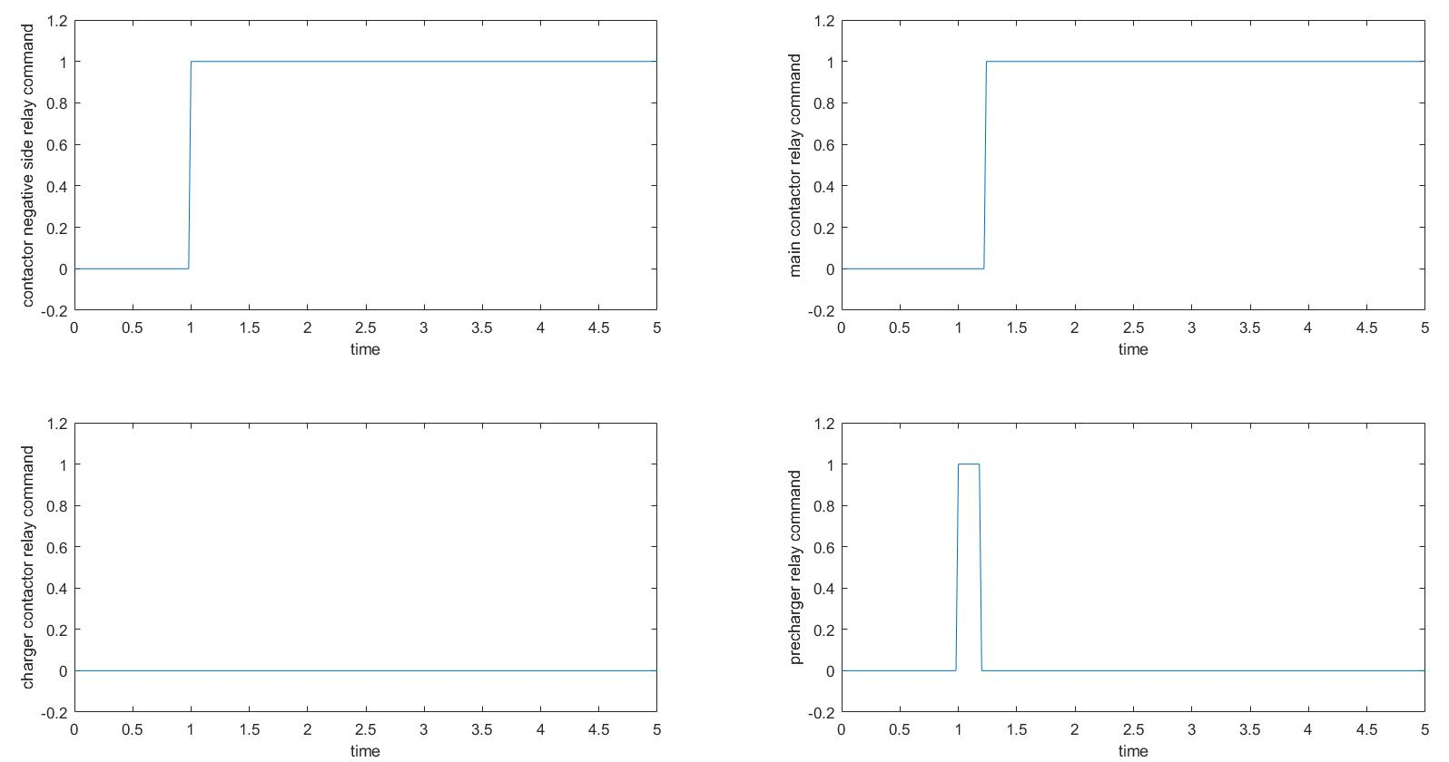
Contactor Control Test Results: Test 1 Outputs
The four output signals are shown above for test case 1
The contactor negative side relay is connected after 1 second when we set main contactor control to 1
The pre-charger contactor also closed after 1 second
After the voltage reach to a calibratable level, the pre-charger is open and the main contactor is closed

Slide 6
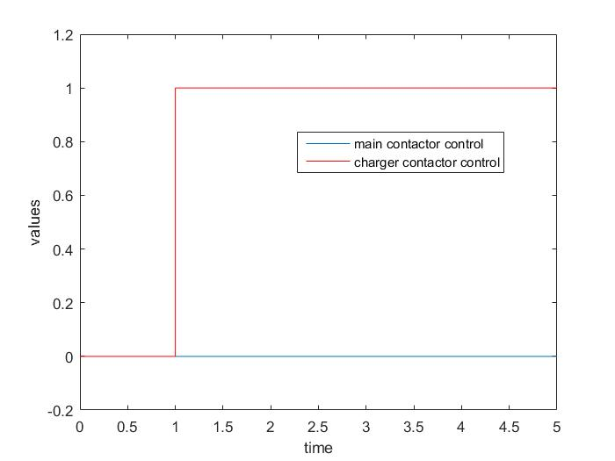
Contactor Control Test Results: Test 2 Inputs
In the second test, we set the charger contactor control signal to be 1 after 1 seconds as shown above
The main objective is to check if the charger contactor relay and the contactor negative side relay are functional properly

Slide 7
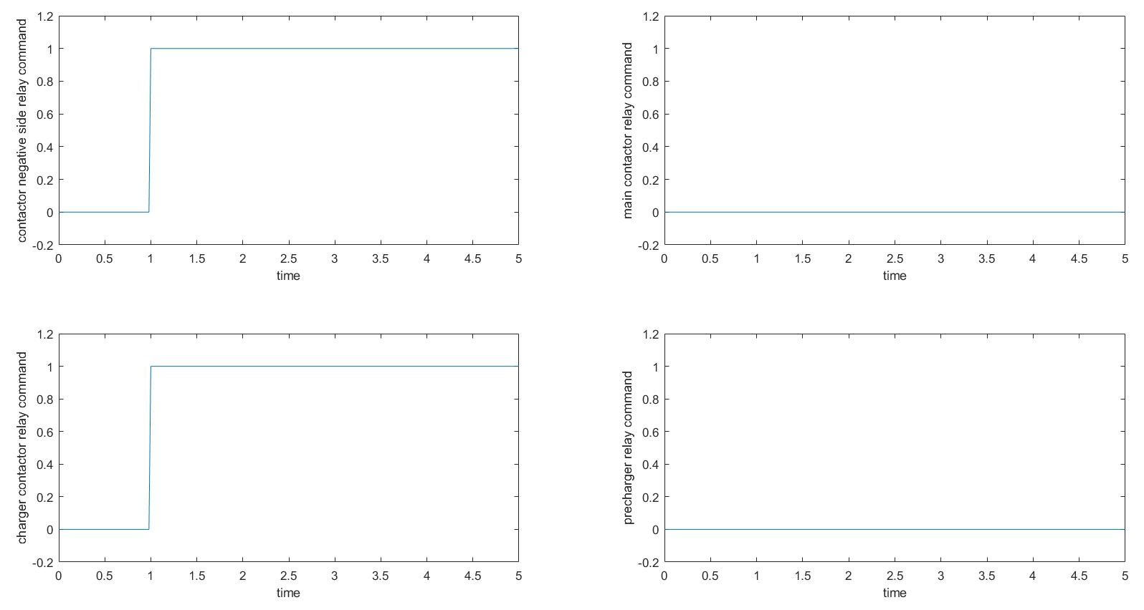
Contactor Control Test Results: Test 2 Outputs
The four output signals are shown above for test case 2
We can see that both the charger contactor relay and contactor negative side relay are set to 1 after 1 second when the charger contactor control is set to 1

